Slide 1
Object-oriented Programming
Week 4 | Lecture 3

Slide 2
Initializing one object with another
class A
{
int val;
public:
A(int val) { this->val = val; }
A(){ }
void setVal(int val) { this->val = val; }
void showVal() { cout << "Value: " << val << endl; }
};

Slide 3

Initializing one object with another
int main()
{
A a1( 10 );
a1.showVal( );
A a2 = a1;
a2.showVal( );
a2.setVal( 20 );
a1.showVal( );
a2.showVal( );
}

Slide 4
Initializing one object with another
int main()
{
A a1( 10 );
a1.showVal( );
A a2 = a1;
a2.showVal( );
a2.setVal( 20 );
a1.showVal( );
a2.showVal( );
}
OUTPUT:
Val: 10 a1.val
Val: 10 a2.val
Val: 10 a1.val
Val: 20 a2.val

Slide 5
Initializing one object with another
int main()
{
A a1( 10 );
a1.showVal( );
A a2;
a2 = a1;
a2.showVal( );
a2.setVal( 20 );
a1.showVal( );
a2.showVal( );
}
OUTPUT:
Val: 10 a1.val
Val: 10 a2.val
Val: 10 a1.val
Val: 20 a2.val

Slide 6
Copy Constructor
A copy constructor is used to initialize an object using another object of the same class
A copy constructor has the following prototype:
ClassName (const ClassName &ob);

Slide 7
Copy Constructor
If we don’t define our own copy constructor, the compiler creates a default copy constructor for each class
The default copy constructor performs member-wise copy between objects
Default copy constructor works fine unless an object has pointers or any runtime allocation

Slide 8
Copy Constructor
In C++, a Copy Constructor may be called when:
1) An object of the class is returned by value 2) An object of the class is passed (to a function) by value as an argument 3) An object is constructed based on another object of the same class 4) The compiler generates a temporary object

Slide 9
Shallow Copy
Default constructor always perform a shallow copy
Changes made by one object are also made for the other object

Slide 10
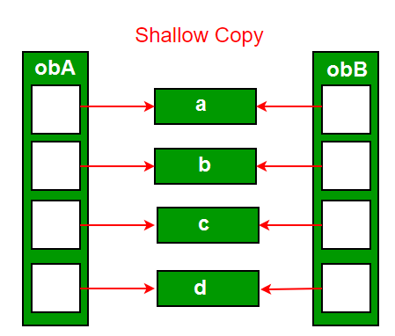
Shallow Copy

Slide 11
Deep Copy
Deep copy is only possible with user-defined copy constructors
In user-defined copy constructors, we make sure that pointers (or references) of copied object point to new memory locations

Slide 12
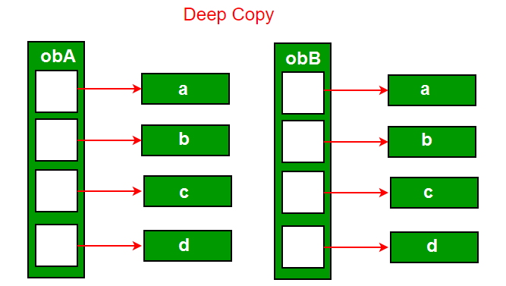
Deep Copy

Slide 13
class A
{
char *s; int size;
public:
A(const char *str = NULL)
{
size = strlen(str);
s = new char[size+1];
strcpy(s, str);
}
A(const A& ob)
{
size = ob.size;
s = new char[size+1];
strcpy(s, ob.s);
}
~A( ) { delete [] s; }
void print() {cout << s << endl;}
void change(const char *str)
{
delete [] s;
size = strlen(str);
s = new char[size+1];
strcpy(s, str);
}
};

Slide 14
int main()
{
A a1("Old string");
A a2 = a1;
a1.print();
a2.print();
a2.change("New string");
a1.print();
a2.print();
}
OUTPUT:
Old string a1.s
Old string a2.s
Old string a1.s
New string a2.s

Slide 15

Why copy constructor?
If we remove copy constructor from the above program, we don’t get the expected output
The changes made to a2 reflect in a1 as well which is never expected

Slide 16

Why copy constructor?
We do not need user-defined copy constructor until there are pointers and dynamic memory allocations

Slide 17
int main()
{
// with no copy constructor
A a1("Old string");
A a2 = a1;
a1.print();
a2.print();
a2.change("New string");
a1.print();
a2.print();
}
OUTPUT:
Old string a1.s
Old string a2.s
New string a1.s
New string a2.s

Slide 18

Discussion
Can we make copy constructor private?
Why argument to a copy constructor should be const?

Slide 19
const Argument for Copy Constructor
class Test
{
/* Class data members */
public:
Test(Test &t) { /* Copy data members from t*/}
Test() { /* Initialize data members */ }
};

Slide 20
const Argument for Copy Constructor
Test func()
{
cout << "func() Called\n";
Test t;
return t;
}
int main()
{
Test t1;
Test t2 = func(); \\Error at this line
return 0;
}

Slide 21
Solutions
Solution 1: Modify copy constructor:
Test(const Test &t) { /* Copy data members*/}
Solution 2: Or do this (overloaded assignment operator):
Test t2;
t2 = func();

